Slide 1
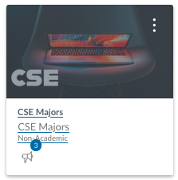

CSE 111 Week 01
W. Clements

Slide 2
Classroom arrangement

Slide 3
Classroom arrangement or as close as we can manage
Floor Edge
Floor Edge
Front of Classroom
Front of Classroom

Slide 4
Welcome to the Class
5 min: Make a list of three thing you like to do?
5 min: Find 3-4 people that like to do one or more of those things.
You are now a group.
Get each others contact information.

Slide 5
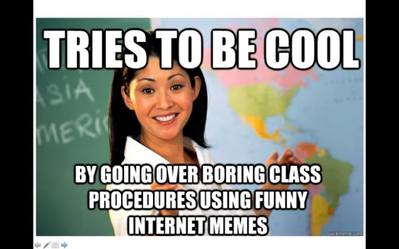
A little about me… Myth: Don’t talk to strangers
20+ Years experience
Masters: Univ of CO @ Denver; Bachlors; BYU-Provo; Associates: Ricks College
Worked for Northrop Grumman (TRW) for 13 years, Raytheon for 5 years
Been teaching for 8 years: Online, Hybrid, and Campus for Community Colleges of Colorado, BYU-Online, and BYU-Idaho
I love computing, I have since I saw my first for-loop fill the screen with my name.
I have moved over 20x, CA, UT, ID, MO, OK, TX, CO
Hobbies: Board Games, Family outings

Slide 6
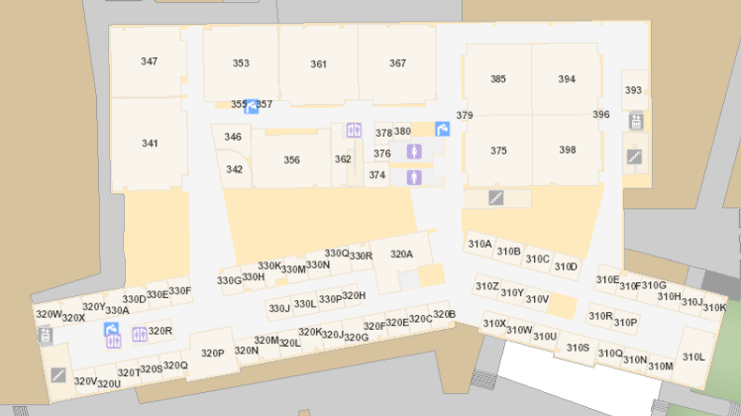
Bro Clements
William Clements
Email: ClementsW@byui.edu
Google Phone: (208) 557-4333
Office Phone: 208-496-7617
Office Rm: 320 T (Mark Twain with a T – Samuel Clemens)

Slide 7
Welcome to the Class
What do you know about the class?
What do you want out of the class?
Why is it important?

Slide 8
Overview
Prepare
Setup & Review
Checkpoint
Icebreaker
Teach: Class Activity
Prove: Milestone
Ponder: Check your understanding

Slide 9
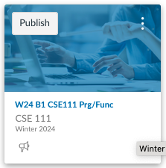
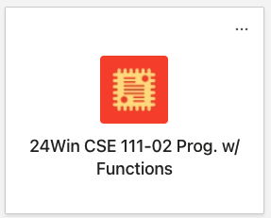
Syllabus
Found in iLearn
Honor Code –
No hats
ChatGPT/LLM/etc
Accessibility
I am flexible, Do the Work - get the grade.
Harassment
a safe and respectful environment
Personal Late Policy
Turn something in – even a note of when you will turn it in.
Learning Class - Resubmissions are allowed
Class Cash
Tuition?
Name Tents
Names are important
Help me, help you, help me.
You get Class Cash for comping to class with Name Tent
Auction every Thursday.

Slide 10

Syllabus – Policies - Honor Code
You may work with your classmates, but all submitted work must be original.
The penalty for copying or plagiarizing of assignments might be one or more of the following: zero on an assignment, being asked to withdraw from the class, a failing grade in the class, or disciplinary action by the university.
Homework assignments are to be completed as scheduled.
Late work is generally not accepted. However, assignments may be rescheduled for a limited number of emergency situations if you discuss your situation with me before (not on and especially not after) the scheduled due date. There will be no routine extensions of due dates; be prepared to justify any requests for extensions.

Slide 11

Accessibility
BYU-Idaho is committed to providing a working and learning atmosphere that reasonably accommodates qualified persons with disabilities. Reasonable academic accommodations are reviewed for all students who have qualified documented disabilities. Services are coordinated with the student and instructor by BYU-Idaho Disability Services. If you need assistance or feel you have been unlawfully discriminated against on the basis of disability, you may seek resolution through established policy and procedures.
If you have any disability that may impair your ability to complete this course successfully, please contact Disability Services as soon as possible, preferably before the beginning of the semester, in order to ensure that you receive appropriate accommodations.
Disability Services Contact Information:
Phone: (208) 496-9210
Email: disabilityservices@byui.edu
Fax: (208) 496-5210
Website: http://www.byui.edu/disabilities/disability-services

Slide 12
Sexual Harassment
Treat everyone with respect...
BYU-Idaho is committed to promoting and maintaining a safe and respectful environment for the campus community. Sexual misconduct is against the law, contrary to the teachings of The Church of Jesus Christ of Latter-day Saints and the Honor Code, and inconsistent with the life and teachings of Jesus Christ, which we hope are embodied on our campus. The university prohibits sexual misconduct perpetrated by or against university students, university employees, participants in university programs, or visitors to its campus, whether the behavior occurs on or off campus.
Read about Title IX for more information.

Slide 13

Course Organization
Each lesson is organized as follows:
Prepare:
Preparation Material—Links will be provided to videos and reading material that should be completed individually prior to moving on to the rest of the lesson.
Checkpoint 15%—A small individual programming assignment designed to help you practice the mechanics of the reading.
Teach:
Team Activity 20%—A 1-hour programming activity to be completed with 3–5 other students. Face-to-face students will complete this activity during class. Online students will arrange a synchronous video conference.
Prove:
Programming Assignment 50%—A large individual programming project. Many of these span two lessons, with a milestone deliverable coming due at the end of the first lesson.
Ponder:
Check your understanding 10%—Every other lesson will have a multiple-choice quiz to help you check your understanding of the topic.
Reflection 5%—Every other week will contain 2–3 short response questions to allow you to reflect on the things you are learning.

Slide 14
Schedule Due Dates
Week | Monday | Tuesday | Wednesday | Thursday | F | S | Topics
1 01/08 | Prepare 01 Ice Breaker | 01 Milestone 01 Ponder | 02 Prepare L02 Checkpoint | L02 Teach L02 Ponder L02 Prove |  |  | Getting Started Calling Functions Project: Inventory Program
2 01/15 | L03 Prepare L03 Checkpoint | L03 Teach L03 Ponder L03 Milestone | L04 Prepare L04 Checkpoint | L04 Teach L04 Ponder L04 Prove |  |  | Writing Functions Function Details Project: Turning Test Program
3 01/22 | L05 Prepare L05 Checkpoint | L05 Teach L05 Ponder L05 Milestone | L06 Prepare L06 Checkpoint | L06 Teach L06 Ponder L06 Prove |  |  | Testing Functions Troubleshooting Functions Project: Water Distribution Program
4 01/29 | L07 Prepare L07 Checkpoint | L07 Teach L07 Milestone L07 Ponder | L08 Checkpoint L08 Prepare | L08 Teach L08 Ponder L08 Prove |  |  | Lists and Repetition Dictionaries Project: Chemistry Formulas
6 02/05 | L09 Prepare L09 Checkpoint L10 Prepare | L09 Teach L09 Ponder L09 Milestone | L10 Prepare L10 Checkpoint | L10 Teach L10 Ponder L10 Prove |  |  | Text Files Handling Exceptions Project: Grocery Receipt
7 02/12 | L11 Prepare L11 Checkpoint | L11 Teach L11 Ponder L11 Milestone | L12 Prepare L12 Checkpoint | L12 Teach L12 Ponder L12 Prove |  |  | Functional Programming Using Objects Project: Heart Rate & Physics Equation
8 02/19 | L13 Prepare L14 Prepare | L13 Ponder L13 Prove | L14 Prove |  |  |  | Project: Significant Program Conclusion
Odd
Even

Slide 15
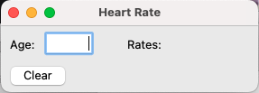
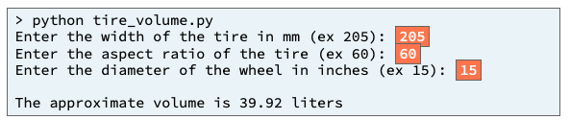
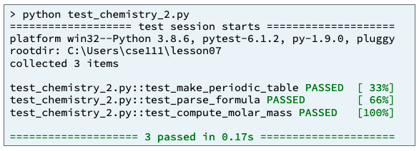
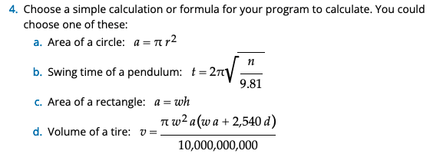
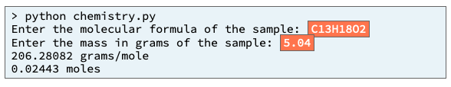
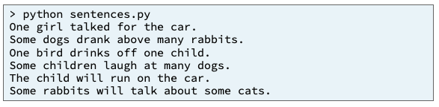
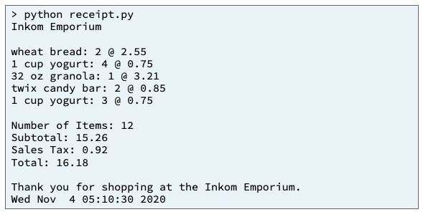
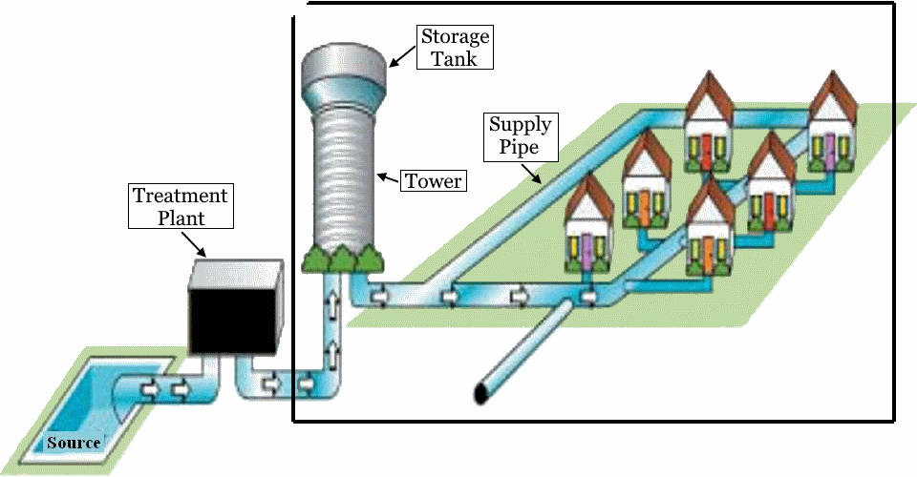
Preview of Projects – 50%
Chemistry Program
Heart Rate & Physics Equation
Inventory Program
Sentence Program
Receipt Program
Student Chosen Program
solves a real-world problem
Water Distribution Program
useful in your major or hobby.
https://byui-cse.github.io/cse111-course/lesson11/prove.html

Slide 16
Prepare
Development Environment
Videos: Introducing Python, Getting Started, Configuring MS Code
Install the Python programming language version 3.10
Install a text editor named Visual Studio Code
Create a folder named cse111 where you will save your Python programs
Download and Open sample Python program to ensure your computer is ready
Install the Microsoft Python extension inside VS Code
Run the sample Python program to ensure your computer is ready

Slide 17
Review Python
Comments
User Input
Variables
Data Types
Display Results
Operators – Arithmetic, Short, Logic
If Statement
Can of Nothing
Special Characters

Slide 18
How to program?
Understand the Problem (Data Transformation)
Have I read the entire assignment?
What are the inputs?
Looking at the examples, what test data is being used?
What are the outputs?
What is the output from the program producing?
How do inputs become outputs?
Do I understand the path of transformation that is occuring?
What programming tools (vocabulary) do I know to figure out the What and How?
From the example, do I understand the architecture of the program?
Do you know which vocabulary should be used?
And in which order?

Slide 19




Input
Process
Output
Main
Input-only
Processing
Update
Output-only
Keyboard
File
Try/accept
Filter
Map
Reduce
Test/assert
List
Dictionary
Display
File
Gui
Debug
Value

Slide 20
Understand the Problem (Data Transformation)
Have I read the entire assignment?
What are the inputs?
Looking at the examples, what test data is being used?
How do inputs become outputs?
Do I understand the path of transformation that is occurring?
What are the outputs?
What is the output from the program producing?
Input
Process
Output
main
Input-only
Processing
Update
Output-only
Keyboard
File
Try/accept
Filter
Map
Reduce
Test/assert
List
Dictionary
Display
File
Gui
Debug
Value

Slide 21
Program
Input
Magic
(equations)
(algorithms)
(etc)
Process
Output
Str prompt
Patterns:
Var = var operator var
#:operators: +, -, *, /, //, %, **
Var = var.function()
⌨️
input(<str>
Str “”
=
Var
Strings: +, .functions()
Numbers: math
float( )
If(decimal)
int( )
bool:operators (==, <, > <=, >=)
If(whole)
If boolean:
With open(“filename”) as filereference
T-statements
F-statements
T-statements
while boolean:
Var
F-statements
+
f”. {} “
:.#f
for boolean:
If(decimal)
T-statements
str( )
F-statements
str( )
“ {} “.format(var..)
If(whole)
If(str)
📺
VarStr = input(“prompt?”)
VarF = float(VarStr)
VarI = int(VarStr
def functionname (parameters,..)
return value
Str “”
print(<str>)
“ “, \t, \n

Slide 22
Program
Input
Magic
(equations)
(algorithms)
(etc)
Process
Output
Str prompt
Data/Model
Patterns:
Var = var operator var
#:operators: +, -, *, /, //, %, **
Var = var.function()
⌨️
input(<str>
Str “”
=
Var
Strings: +, .functions()
Numbers: math
float( )
If(decimal)
int( )
Process
If(whole)
bool:operators (==, <, > <=, >=)
With open(“filename”) as filereference
If boolean:
Var
T-statements
F-statements
T-statements
while boolean:
+
f”. {} “
:.#f
If(decimal)
F-statements
str( )
for boolean:
str( )
“ {} “.format(var..)
T-statements
If(whole)
F-statements
If(str)
📺
VarStr = input(“prompt?”)
VarF = float(VarStr)
VarI = int(VarStr
Str “”
print(<str>)
def functionname (parameters,..)
return value
“ “, \t, \n

Slide 23
Program
Input
Data
Process
Output
Storage
Sequence
(Order)
Selection
(Branching)
Iteration
Variable
(int, str, float)
Prompt User
(string)
Variable
(int, str, float)
Input
Process
Output
conditions
+
=Input(string)
==, <, <=, >, >=, !=, in
If decimal
str()
⌨️
💾
Int/float operators
If number
str()
Set values
Check condition
one choice
if boolean:
while boolean:
with open(filename) as file_variable:
+,-,*,/,//,%,**
2 choices
if boolean:
else:
for boolean:
String operators
Set values
while exitvar == True
Update exit
f”. {} “
for var in list:
+, .functions()
If decimal
float()
3+ choices
if boolean:
elif: Boolean:
else:
lists operators
“{}“.format(var..)
If number
int()
List
For
print
[.,.], [i], in, len(), range
string
print(<str>)
Storage
Sequence (Coupling/Cohesion)
Selection (Branching)
Iteration (Loops)
Def functions()
📺

Slide 24
Icebreaker
MS Teams
Install MS Teams or use Web
Getting into MS Teams
Only byui.edu account
Link and Acceptance
General channel
Introduction channel
Introduction channel
Introduce yourself there. Feel free to include a picture, where you're from, interesting or odd information about you, etc.
In addition to introducing yourself, briefly share a time in your life where you had to overcome a challenge—particularly one where you didn't think you could succeed (for example learning a language, taking a difficult class, starting a new job, learning a new technology, etc.) What was the challenge?
How did you overcome it?
What did you learn from that experience?
How can you apply those lessons learned to your experience in this course?
Make comments on others’ posts.

Slide 25
Communication
MS Teams – CSE 110 – Fall 2020
https://teams.microsoft.com/l/team/19%3acdfe7c49064844deb8292d7aeb08e78d%40thread.tacv2/conversations?groupId=764a0054-ad62-4775-8b2a-ef470d2d7d99&tenantId=e6ac1d1f-d695-4ef1-91d4-94cddef8be11
Zoom
Zoom: Meeting ID: 943 9216 7469 Passcode: 608544

Slide 26
Program
Input
Process
Output
Storage
Sequence
(Order)
Selection
(Branching)
Iteration
Variable
(int, str, float)
Prompt User
(string)
Variable
(int, str, float)
Input
Process
Output
conditions
+
=Input(string)
==, <, <=, >, >=, !=, in
If decimal
str()
⌨️
💾
Int/float operators
If number
str()
Set values
Check condition
one choice
if boolean:
while boolean:
with open(filename) as file_variable:
+,-,*,/,//,%,**
2 choices
if boolean:
else:
for boolean:
String operators
Set values
while exitvar == True
Update exit
f”. {} “
for var in list:
+, .functions()
If decimal
float()
3+ choices
if boolean:
elif: Boolean:
else:
lists operators
“{}“.format(var..)
If number
int()
List
For
print
[.,.], [i], in, len(), range
string
print(<str>)
Storage
Sequence (Coupling/Cohesion)
Selection (Branching)
Iteration (Loops)
Def functions()
📺

Slide 27
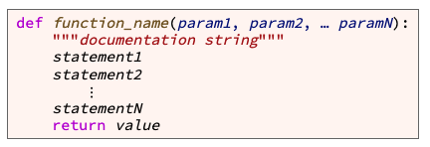
Writing Functions
variable
value
the function name
Start with letter/_, can have a-Z0-9
meaningful
keyword def (which is an abbreviation for "define")
the parameter list (with the parameters separated by commas)
Values are passed in an assigned to variable names.
header or signature
a result value is from a function
Function body

Slide 28
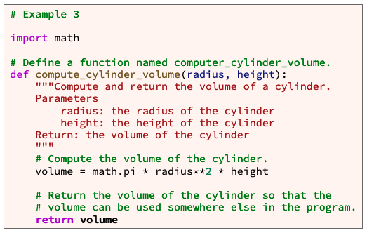
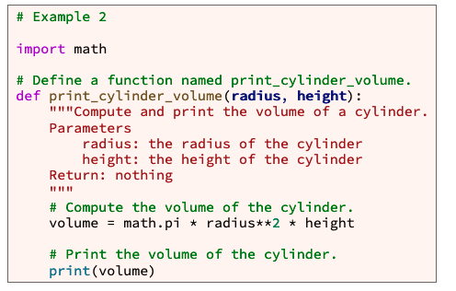
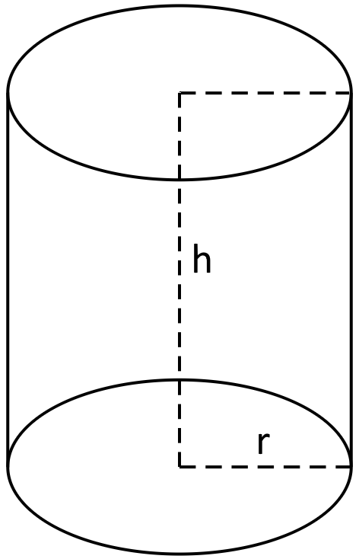
Example
the parameter list (with the parameters separated by commas)
Values are passed in an assigned to variable names.
the function name
Start with letter/_, can have a-Z0-9
meaningful
keyword def (which is an abbreviation for "define")
header or signature
Representation of a real object
That holds values
Function body
a result value is from a function

Slide 29
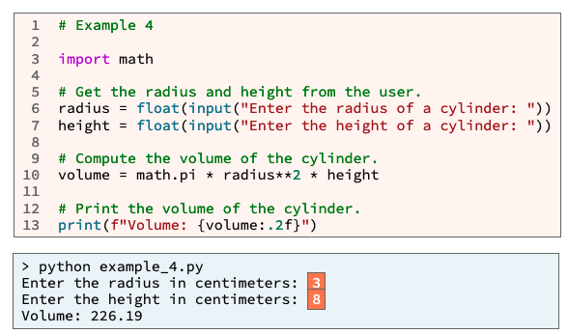
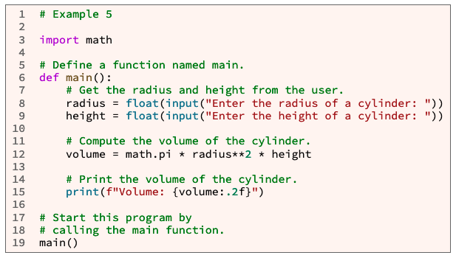
main
Why use main function?
Organization
Writing statements outside a function can lead to poor organization within a large program.
Best Practices
Professional software developers write statements inside a function whenever possible.
No more calling code from the first indentation, except for main

Slide 30
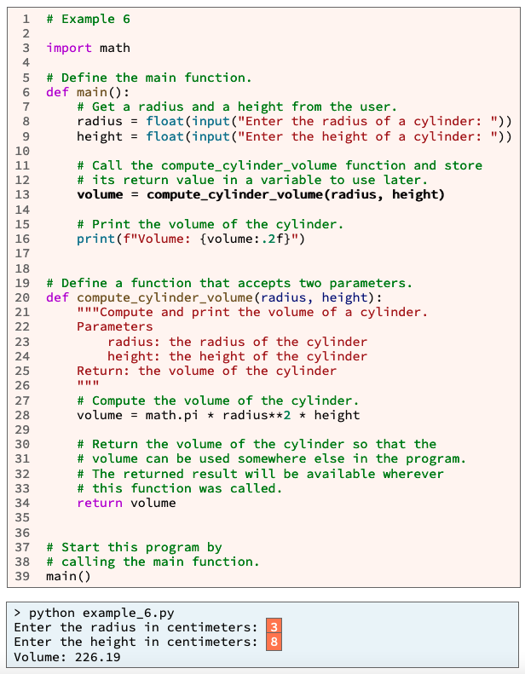
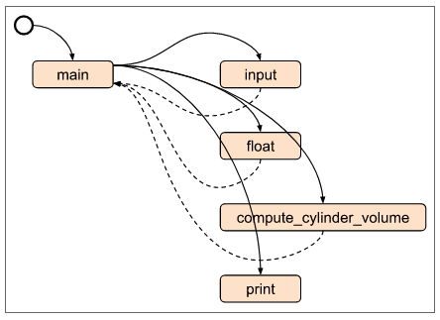
A
1. (A)Python read and compiles the entire file.
Then runs the 1st line of code with zero indentation
i.e. main()
2. Main is called.
Process of input is retrieved and converted (B, C)
3. Within main, compute_cylinder_volume() is called with two parameters.
The variables used pass in the the values they hold.
4. Those values are re-assigned to a new set of variables.
The new variables are used to process the value of volume.
5. The value from volume is return, and stored in main’s volume variable.
6. Main is finished
7. Control flow is return to the next line with no indentation.
Input
Process
Output
2
B
C
B
C
3
3
5
5
D
Value passing
6
D
4
Value Passing
Order of Execution
5
Value passing
1
7
A
B
C
D

Slide 31
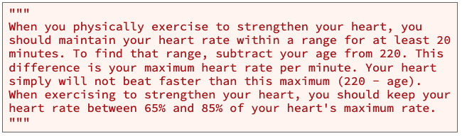
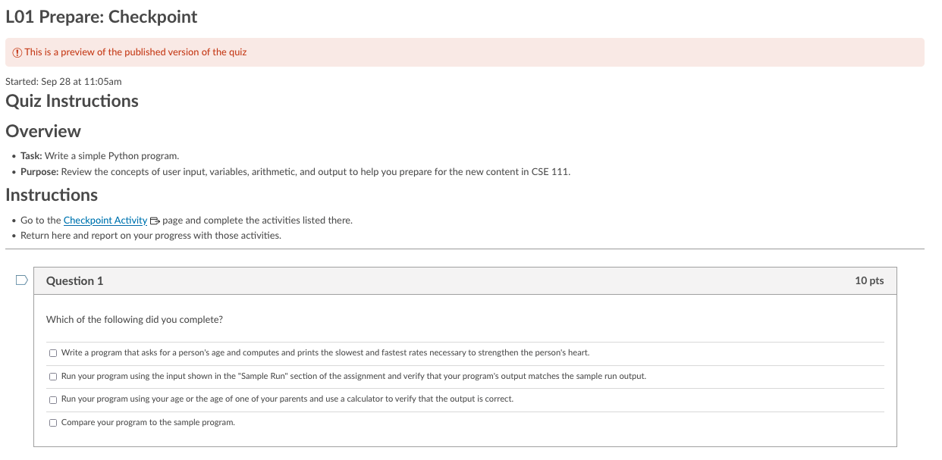
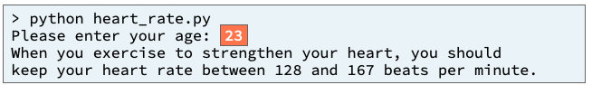
Checkpoint
Purpose: Write a Python program that gets input from a user, uses variables, performs arithmetic, and displays results for the user to see.
Pattern: Get input, process input, display output

Slide 32
Checkpoint
Write a Python program that gets input from a user, uses variables, performs arithmetic, and displays results for the user to see.
Input
Process
Output
main

Slide 33
Checkpoint
Purpose:
Problem statement
Write a Python program that gets input from a user, uses variables, performs arithmetic, and displays results for the user to see.
Pattern: Get input, process input, display output
Example Output

Slide 35
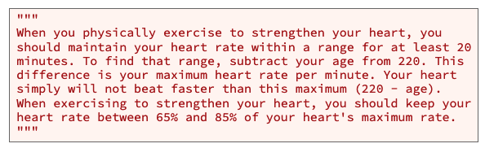
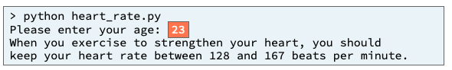
Input
Process
Output
main
Data
What are the values?
Where are they being stored?
Process
What do I do with the values?

Slide 36
Input
Process
Output
?
main
?

Slide 37
Input
Process
Output
main
Get_age()
?
value
?
Display_user_info()

Slide 38
Input
Process
Output
main
Get_age()
age
value
?
lower_rate
Display_user_info()
upper_rate

Slide 39
Input
Process
Output
main
Get_age()
age
value
Max_rate = 220-age
lower_rate = max_rate * .65
Display_user_info()
upper_rate = max_rate * .85

Slide 40
Input
Process
Output
main
Get_age()
age
value
Max_rate = 220-age
lower_rate = max_rate * .65
Display_user_info()
upper_rate = max_rate * .85

Slide 42
Teach: Class Activity 01 Class Activity: Review Python
Purpose: Write a Python program that gets input from a user, uses variables, performs arithmetic using the math module, and displays results for the user to see.

Slide 43
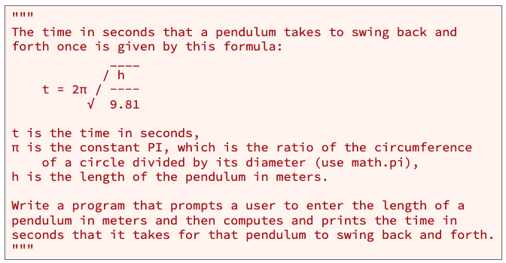
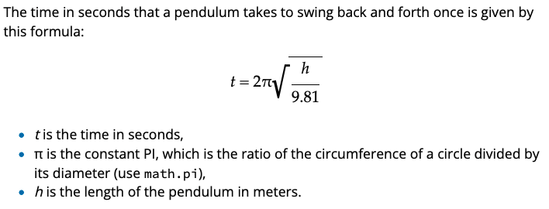
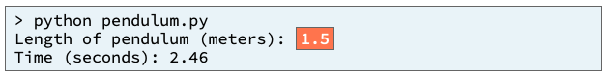
Teach: Class Activity 01 Class Activity: Review Python
Purpose: Write a Python program that gets input from a user, uses variables, performs arithmetic using the math module, and displays results for the user to see.
Problem Statement

Slide 44
Teach: Class Activity 01 Class Activity: Review Python
Purpose: Write a Python program that gets input from a user, uses variables, performs arithmetic using the math module, and displays results for the user to see.
Problem Statement

Slide 45
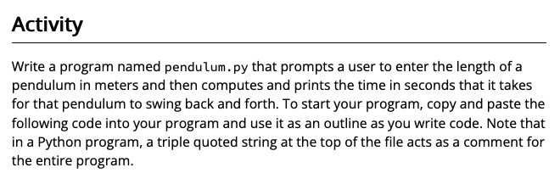
Teach: Class Activity 01 Class Activity: Review Python
Purpose: Write a Python program that gets input from a user, uses variables, performs arithmetic using the math module, and displays results for the user to see.
Problem Statement
Example Output

Slide 46
Teach: Class Activity 01 Class Activity: Review Python
Purpose: Write a Python program that gets input from a user, uses variables, performs arithmetic using the math module, and displays results for the user to see.
Problem Statement
Input
Process
Output
main

Slide 47
?
Input
Process
Output
main

Slide 48
Input
Process
Output
main
?

Slide 49
Input
Process
Output
main
?
Get_length()
value
?
Display_time()

Slide 50
Input
Process
Output
main
Get_length()
length_meters
value
?
Display_time()
Time

Slide 51
Input
Process
Output
main
Get_length()
length_meters
value
?
Display_time()
Time

Slide 52
Input
Process
Output
main
Get_length()
length_meters
value
Display_time()
Time = 2π * sqrt( length / 9.81)

Slide 53
Input
Process
Output
main
Get_length()
length_meters
value
Display_time()
Time = 2π * sqrt( length / 9.81)

Slide 54
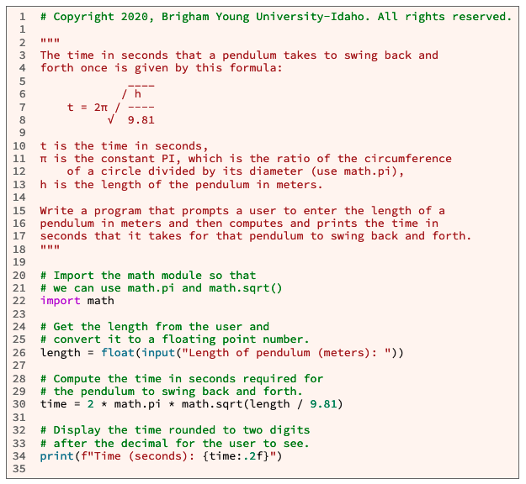
Input
Process
Output
main
Get_length()
length_meters
value
Display_time()
Time = 2π * sqrt( length / 9.81)

Slide 56
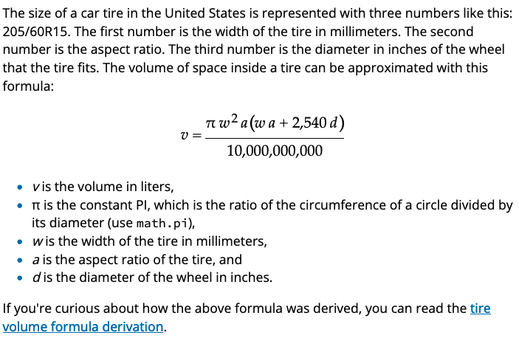
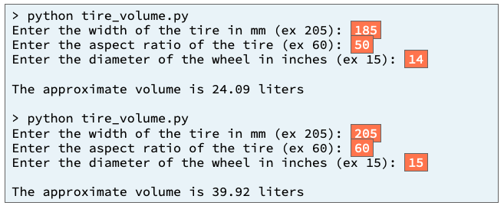
Prove: Milestone 01 Prove Milestone: Review Python
Purpose: Prove that you can write a Python program that gets input from a user, performs arithmetic, and displays results for the user to see.
Problem Statement

Slide 57
Variables needed
V – volume = numerator/10M
Pi
w – width
a – ratio
d – diameter
Numerator = p1*(p2+p3)
Numerator_p1= pi*w2*a
Numerator_p2= w*a
Numerator_p3= 2540*d

Slide 58
Prove: Milestone 01 Prove Milestone: Review Python

Slide 59
Prove: Milestone 01 Prove Milestone: Review Python
Purpose: Prove that you can write a Python program that gets input from a user, performs arithmetic, and displays results for the user to see.
Problem Statement

Slide 60
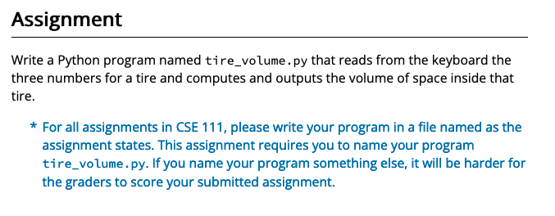
Prove: Milestone 01 Prove Milestone: Review Python
Purpose: Prove that you can write a Python program that gets input from a user, performs arithmetic, and displays results for the user to see.
Problem Statement

Slide 61
Prove: Milestone 01 Prove Milestone: Review Python
Purpose: Prove that you can write a Python program that gets input from a user, performs arithmetic, and displays results for the user to see.
Problem Statement

Slide 62
Prove: Milestone 01 Prove Milestone: Review Python
Purpose: Prove that you can write a Python program that gets input from a user, performs arithmetic, and displays results for the user to see.
Problem Statement

Slide 63
Prove: Milestone 01 Prove Milestone: Review Python
Purpose: Prove that you can write a Python program that gets input from a user, performs arithmetic, and displays results for the user to see.
Problem Statement
Input
Process
Output
main

Slide 64
Input
Process
Output
main

Slide 65
Input
Process
Output
main

Slide 66
Input
Process
Output
main

Slide 67
Input
Process
Output
main

Slide 68
Input
Process
Output
?
main
?

Slide 69
Input
Process
Output
main
Get_width()
value
?
Get_ratio()
?
value
Display_volume()
Get_diameter()
value
volume

Slide 70
Input
Process
Output
main
Get_width()
w_width
value
Get_ratio()
a_ratio
value
d_diameter
Display_volume()
Get_diameter()
value
volume

Slide 71
Input
Process
Output
main
Get_width()
w_width
?
value
Get_ratio()
a_ratio
value
d_diameter
Display_volume()
Get_diameter()
value
volume =

Slide 72
Input
Process
Output
main
Get_width()
w_width
value
Get_ratio()
a_ratio
value
d_diameter
Display_volume()
Get_diameter()
value
volume = numerator/10M

Slide 73
Input
Process
Output
main
Get_width()
w_width
value
Get_ratio()
a_ratio
value
d_diameter
Display_volume()
Get_diameter()
value
volume = numerator/10M

Slide 74
Input
Process
Output
main
Get_width()
w_width
value
Volume = Numerator/10M
Numberator = part1* (part2 + part3)
NumeratorPart1 = pi * (w**2) * a
NumeratorPart2 = w * a
NumeratorPart3 = 2540 * d
Get_ratio()
a_ratio
value
d_diameter
Display_volume()
Get_diameter()
value
volume = numerator/10M

Slide 75
Input
Process
Output
main
Get_width()
w_width
Numerator = p1*(p2+p3)
Numerator_p1= pi*w2*a
Numerator_p2= w*a
Numerator_p3= 2540*d
value
Get_ratio()
a_ratio
value
d_diameter
Display_volume()
Get_diameter()
value
volume = numerator/10M

Slide 76
Input
Process
Output
main
Get_width()
w_width
Numerator = p1*(p2+p3)
Numerator_p1= pi*w2*a
Numerator_p2= w*a
Numerator_p3= 2540*d
value
Get_ratio()
a_ratio
value
d_diameter
Display_volume()
Get_diameter()
value
volume = numerator/10M

